Slide 1



GEO Knowledge Hub
A Digital library for the GEO Work Programme Activities
GEO Week 2022 | Accra, Ghana
31 October — 04 November 2022
Ernest Acheampong (GEO Secretariat)
Florian Franziskakis (GEO Secretariat)
Felipe Carlos (Consultant for GEO Secretariat)

Slide 2
GEO Knowledge Hub
Overview
An open-source digital repository of open, authoritative and reproducible knowledge created by the Group on Earth Observations

Slide 3
GEO Knowledge Hub
Scope
Promote the reproducibility, repricability, and preservation of EO Applications by sharing all the resources essential to fully understand and re-use them

Slide 4
GEO Knowledge Hub
Concepts
Knowledge Resource
Code
Data
Paper
Computing Environment

Slide 5
GEO Knowledge Hub
Concepts
Knowledge Resource
Knowledge Package
Application: Generating crop map with time series classification
Code
Data
Paper
Computing Environment
Application: Detecting deforestation mapping using Linear Mixture Model

Slide 6








GEO Knowledge Hub
Concepts

Slide 7

GEO Knowledge Hub
Concepts

Slide 8
GEO Knowledge Hub
Type of users
Knowledge Provider
Knowledge User
Share materials
Share use cases Help the community
Learn
Apply the knowledge Share experiences

Slide 9
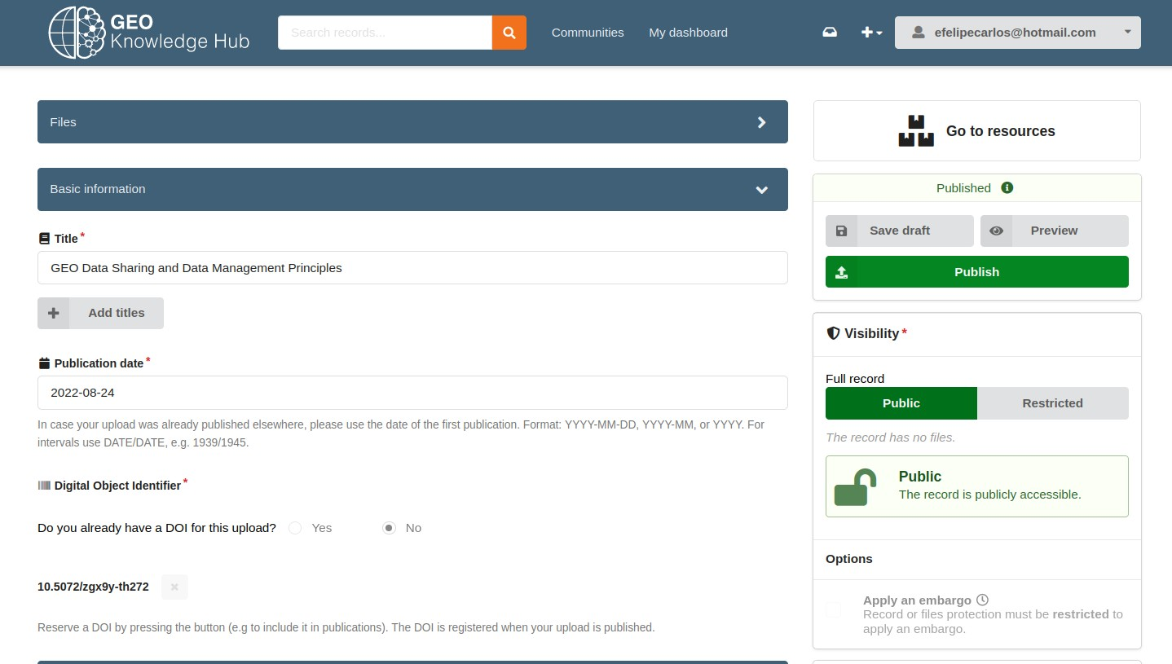
GEO Knowledge Hub
Deposit interface
Knowledge Provider

Slide 10
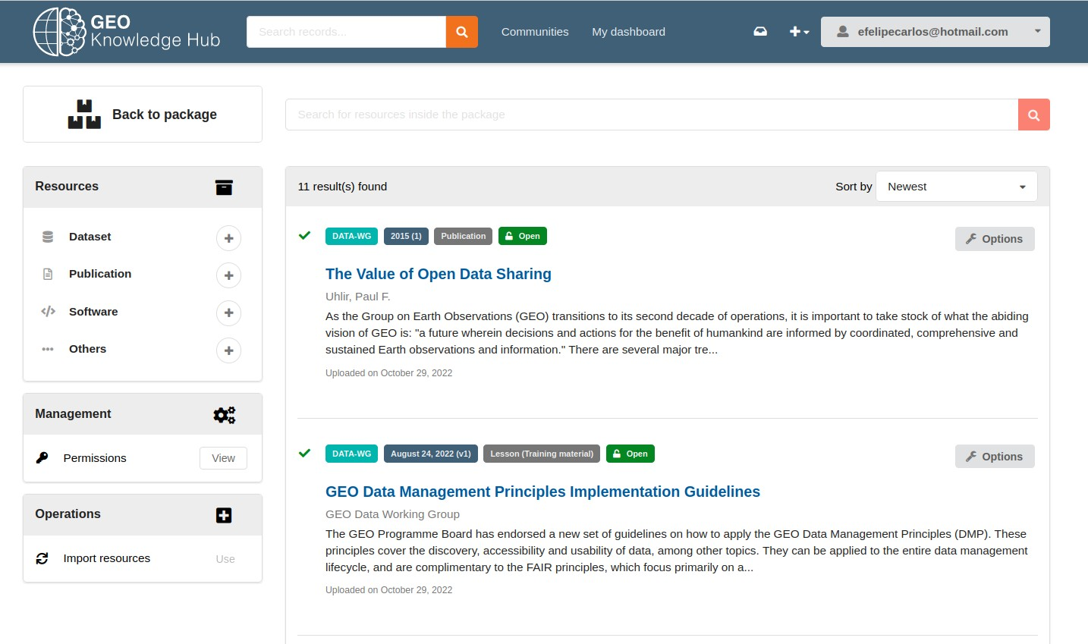
GEO Knowledge Hub
Deposit interface
Knowledge Provider

Slide 11
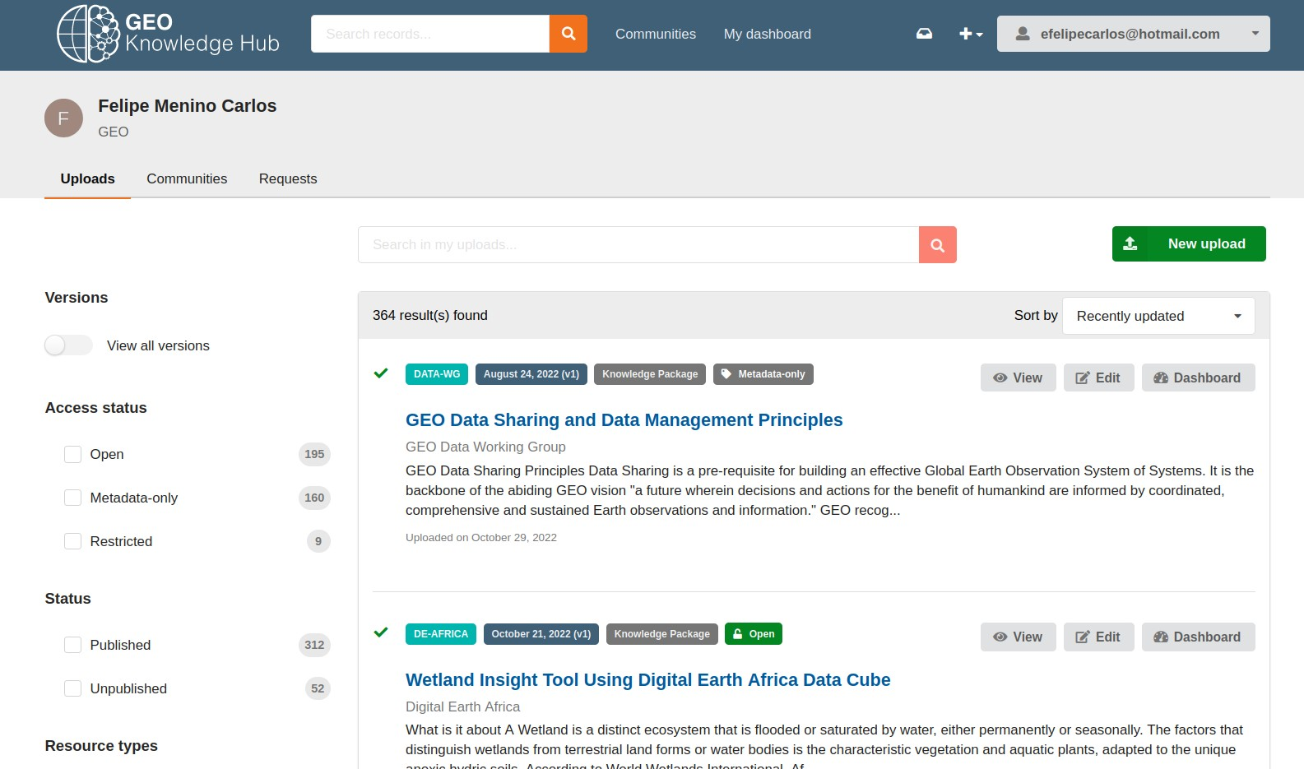
GEO Knowledge Hub
User dashboard
Knowledge Provider

Slide 12
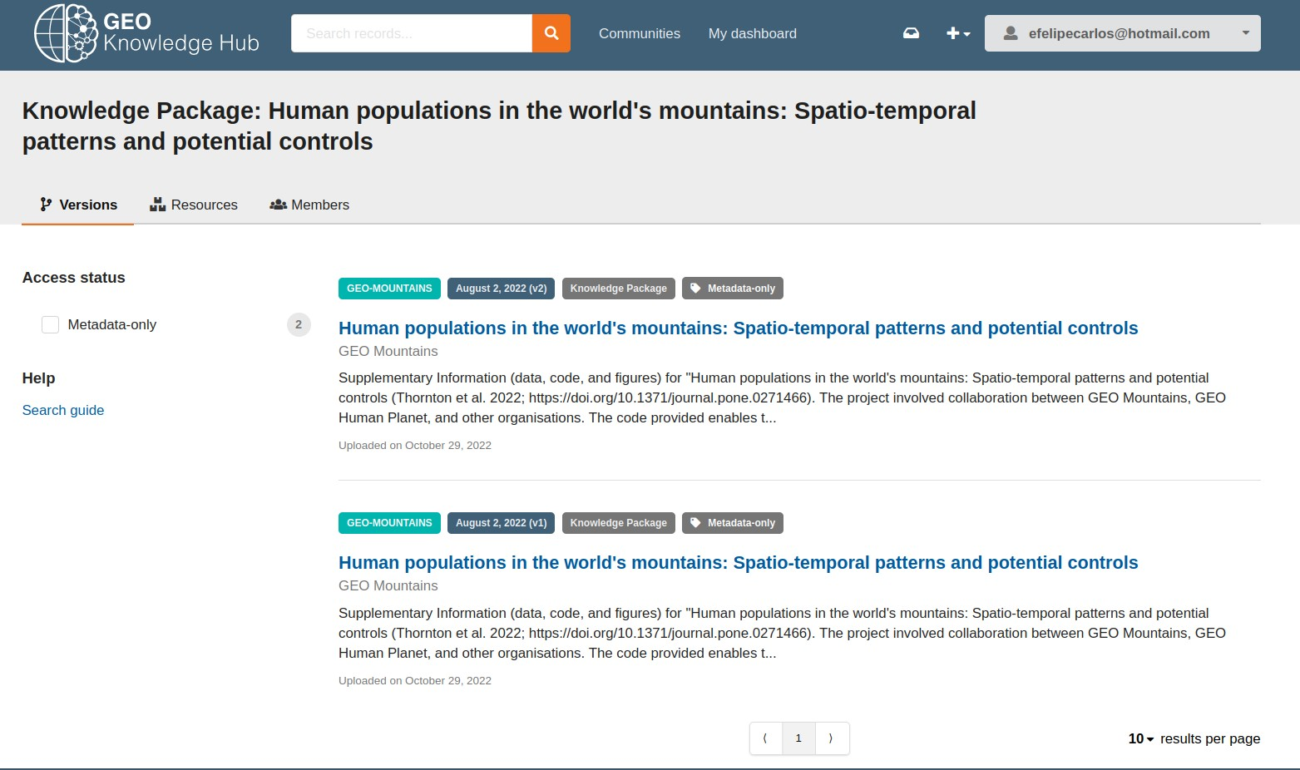
GEO Knowledge Hub
User dashboard
Knowledge Provider

Slide 13
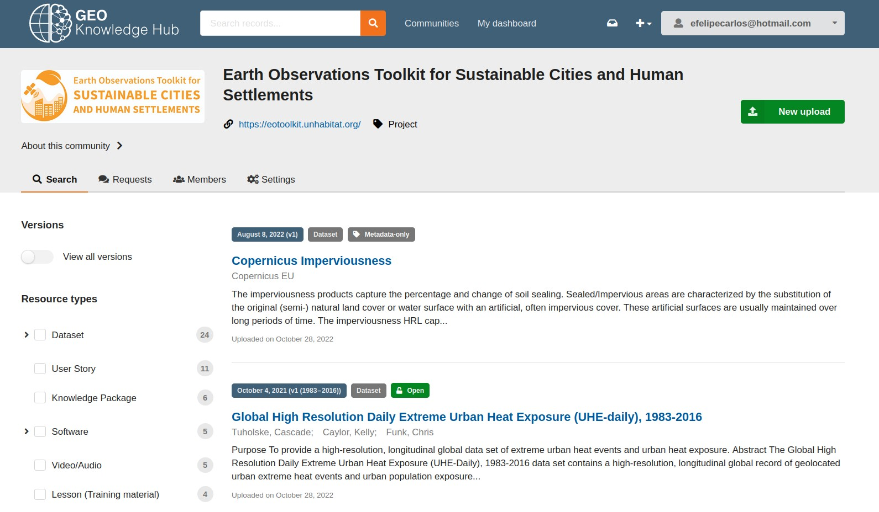
GEO Knowledge Hub
Communities dashboard
Knowledge Provider

Slide 14

GEO Knowledge Hub
Features
Knowledge Provider
Create, manage and share consistent and reproducible packages
The design of the interface helps user to know what must be shared
Communities can create a corner for the GEO Work Programme Activities

Slide 15


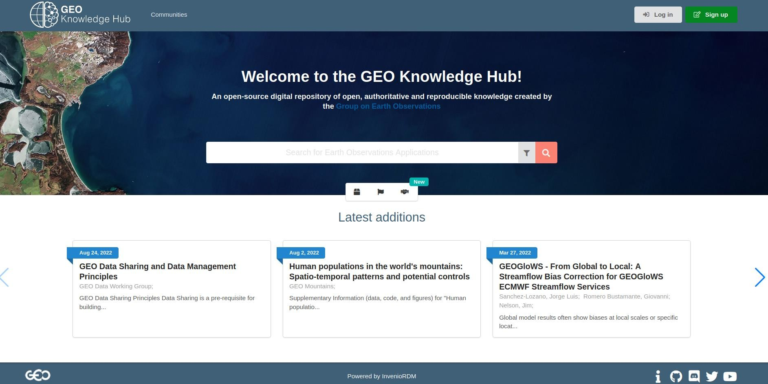
GEO Knowledge Hub
Front page interface
Knowledge User

Slide 16
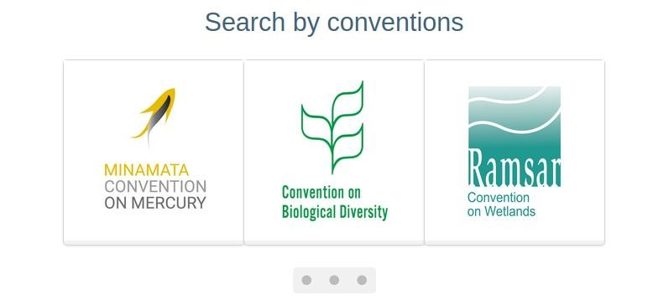
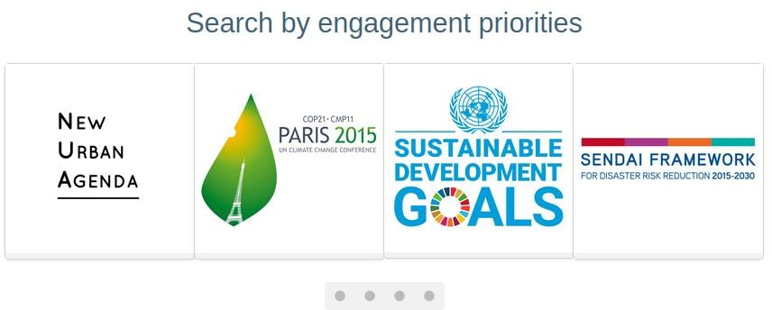
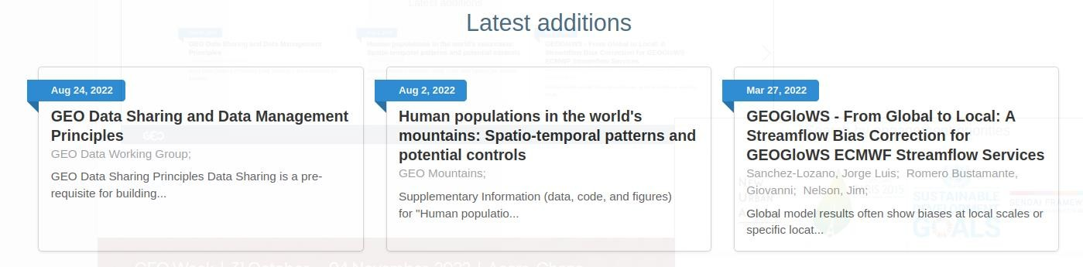
GEO Knowledge Hub
Front page interface
Knowledge User

Slide 17
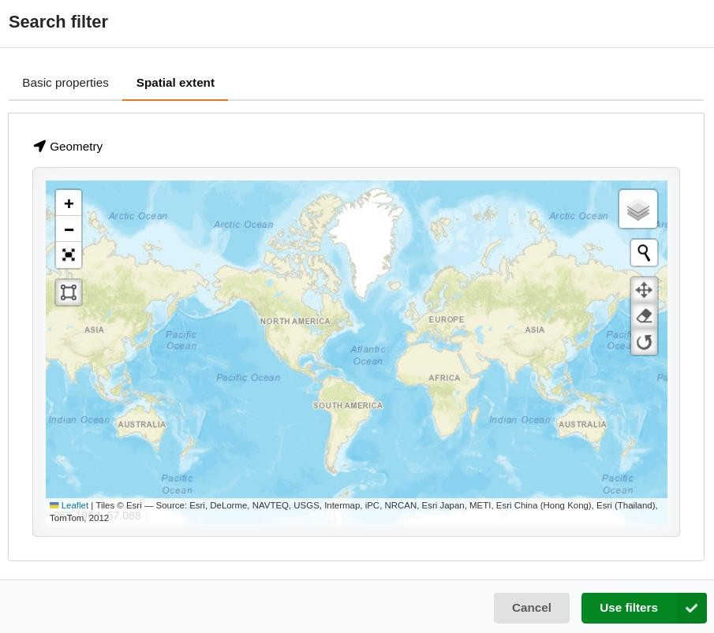
GEO Knowledge Hub
Front page interface
Knowledge User

Slide 18
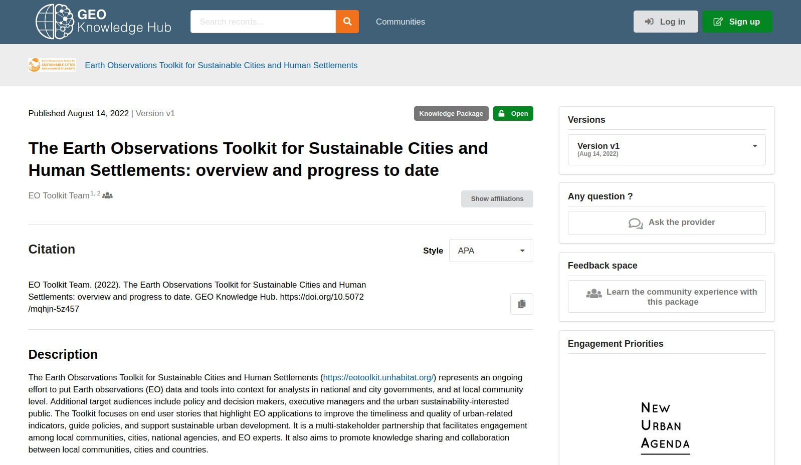
GEO Knowledge Hub
Record landing page
Knowledge User

Slide 19
GEO Knowledge Hub
Record landing page
Knowledge User

Slide 20
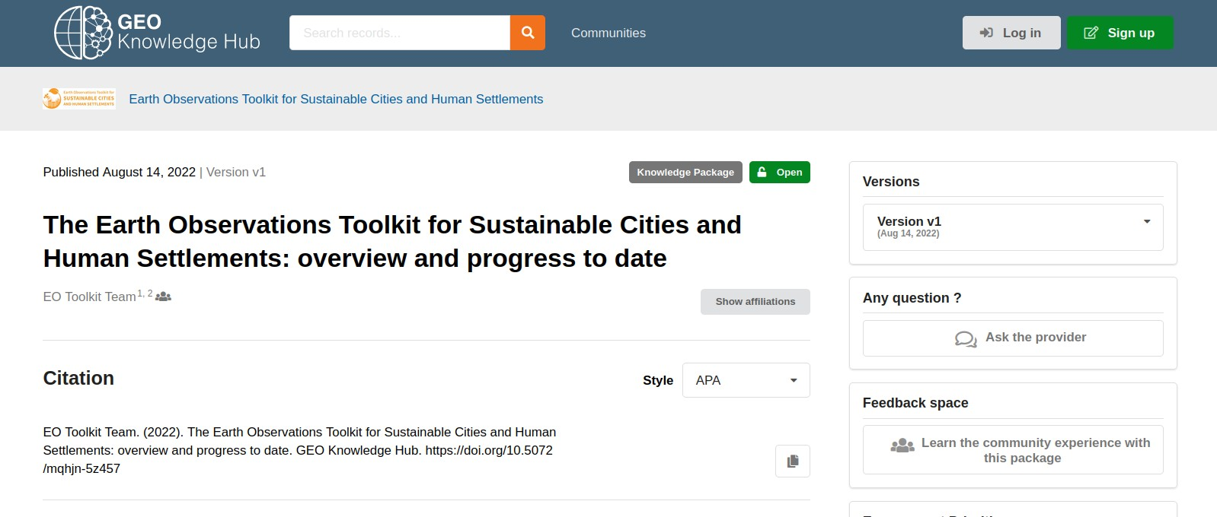
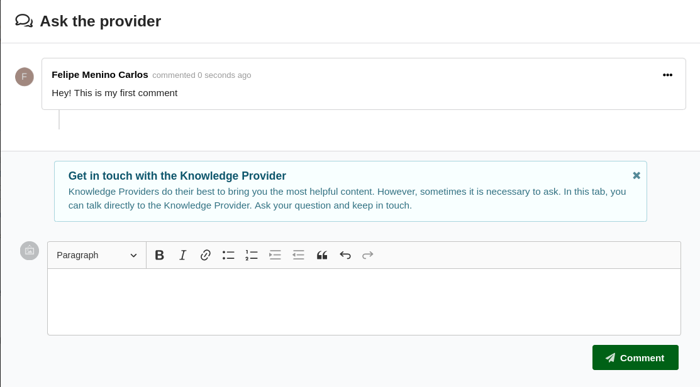
GEO Knowledge Hub
Record landing page
Knowledge User

Slide 21
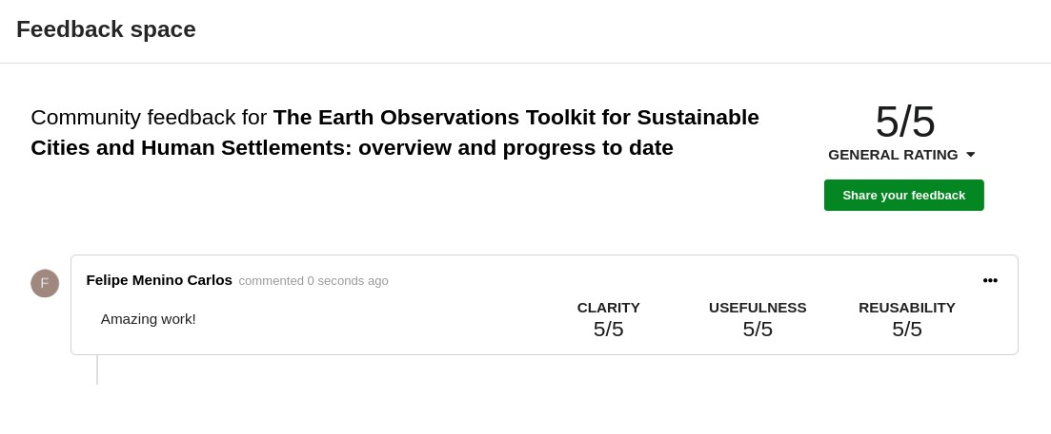
GEO Knowledge Hub
Record landing page
Knowledge User

Slide 22
GEO Knowledge Hub
Record landing page
Knowledge User

Slide 23
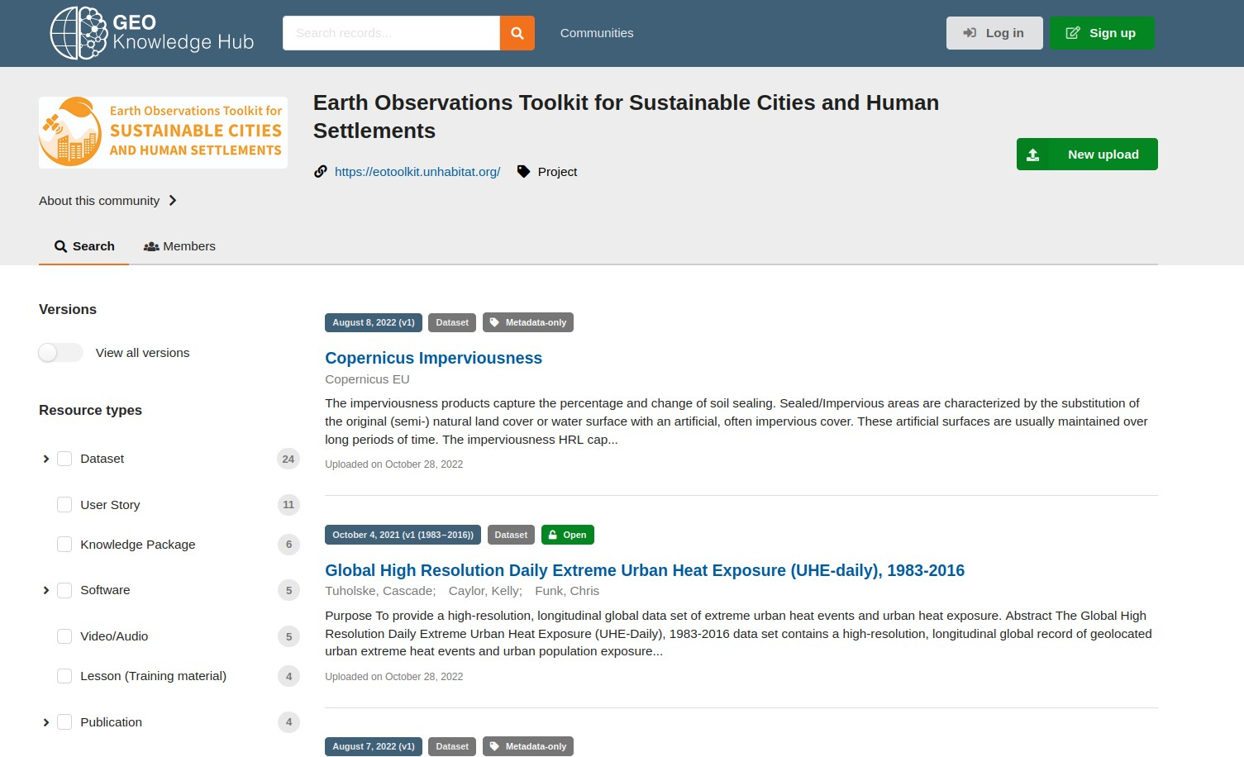
GEO Knowledge Hub
Record landing page
Knowledge User

Slide 24
GEO Knowledge Hub
Features
Knowledge User
Find, learn, and reproduce the packages
Share with the community the experiences with the available materials
Get in touch with the Knowledge Providers, facilitating the usage and
learning steps

Slide 25

GEO Knowledge Hub
Current state
Users: 105
Activities: 12
Records: 298

Slide 26
Join us today!
gkhub.earthobservations.org

